Slide 1

Machine Learning
CS 165B
Prof. Matthew Turk
Wednesday, June 1, 2016
Neural networks (cont.)
Today
Recorded lecture

Slide 2
Notes
This lecture is being recorded, so be sure to use the PowerPoint version to play the lecture (slides and audio)!
Homework assignment #5 due Friday at 4:30pm
Final exam
Practice exam posted soon
Pages of equations, etc. already posted
Wednesday 8-11am in the regular classroom
Just bring a calculator and something to write with

Slide 3
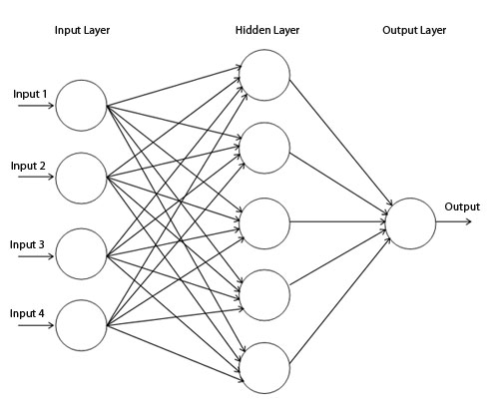
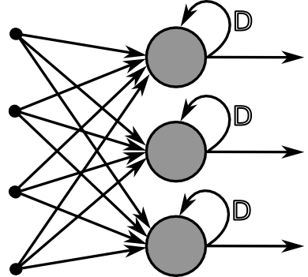
Neural networks
Feedforward network
Information only moves forward, from input to output
A.k.a. multi-layer perceptron
Recurrent network
Directed cycles exist in the network

Slide 4
Typical neural network learning
Review
The target function can be discrete-valued, real-valued, or a vector of several real- or discrete-valued attributes
Training data: attribute-value pairs ($x_{i}, y_{i})$
E.g., for ALVINN, $x_{i}$ is the input (30x32) image, $y_{i}$ is the steering direction
The training data may contain errors (i.e., noisy)
Long training time, fast execution (evaluation) time
E.g., real-time steering response for ALVINN
In training, use gradient descent to search the hypothesis space of possible weight vectors to find the $w$ that best fits the training examples

Slide 5
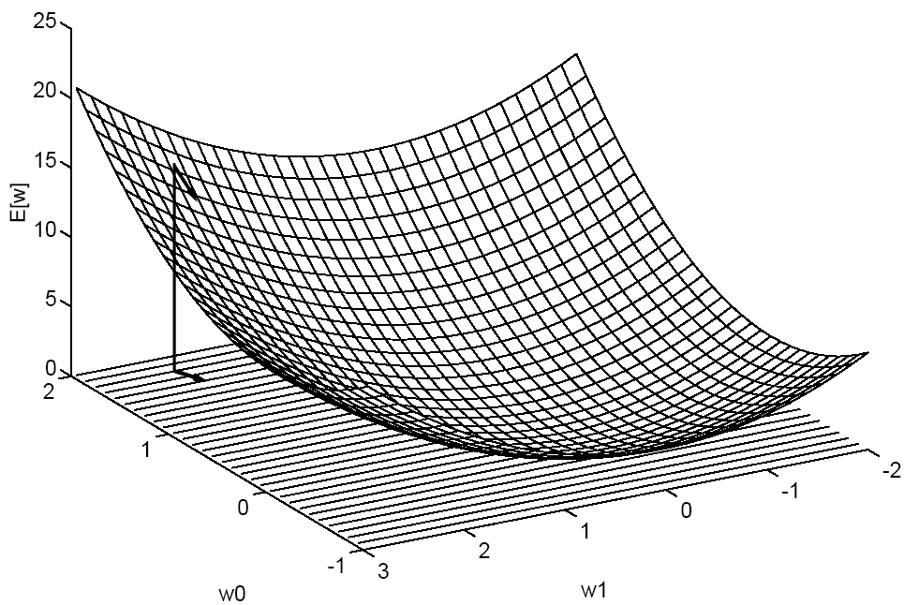
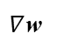
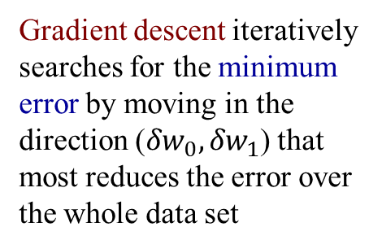
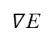
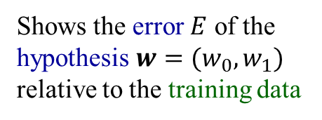
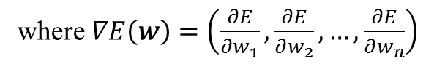
The hypothesis space and gradient descent
$$E\left(w\right)= \frac{1}{2}\sum_{D}{{\left(y_{i}−o_{i}\right)}^{2}}$$
Shows the error $E$ of the hypothesis $w=(w_{0}, w_{1})$ relative to the training data
Training error
E
$∇$E
$∇$w
Gradient descent iteratively searches for the minimum error by moving in the direction (${δw}_{0}, {δw}_{1}$) that most reduces the error over the whole data set
So $Δw=−η∇E(w)$
where $∇E\left(w\right)=\left(\frac{∂E}{∂w_{1}},\frac{∂E}{∂w_{2}}, …,\frac{∂E}{∂w_{n}}\right)$
Gradient of $E$ with respect to $w$

Slide 6
The hypothesis space and gradient descent
Gradient descent is an important general paradigm for learning
Can be applied whenever
The hypothesis space contains continuously parameterized hypotheses
E.g., the weights in a linear unit
The error on training data can be computed with respect to these hypotheses
This will converge to a solution even with noisy, non-separable training data
Practical difficulties in applying gradient descent:
Convergence can be slow (e.g., can require thousands of steps)
Converges to a local minimum – no global guarantee
A common variation is incremental gradient descent (a.k.a. stochastic gradient descent) that updates the weights incrementally after each training example

Slide 7
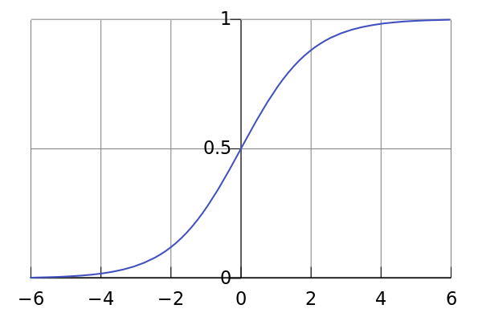
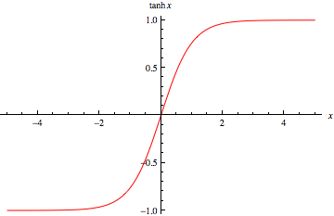
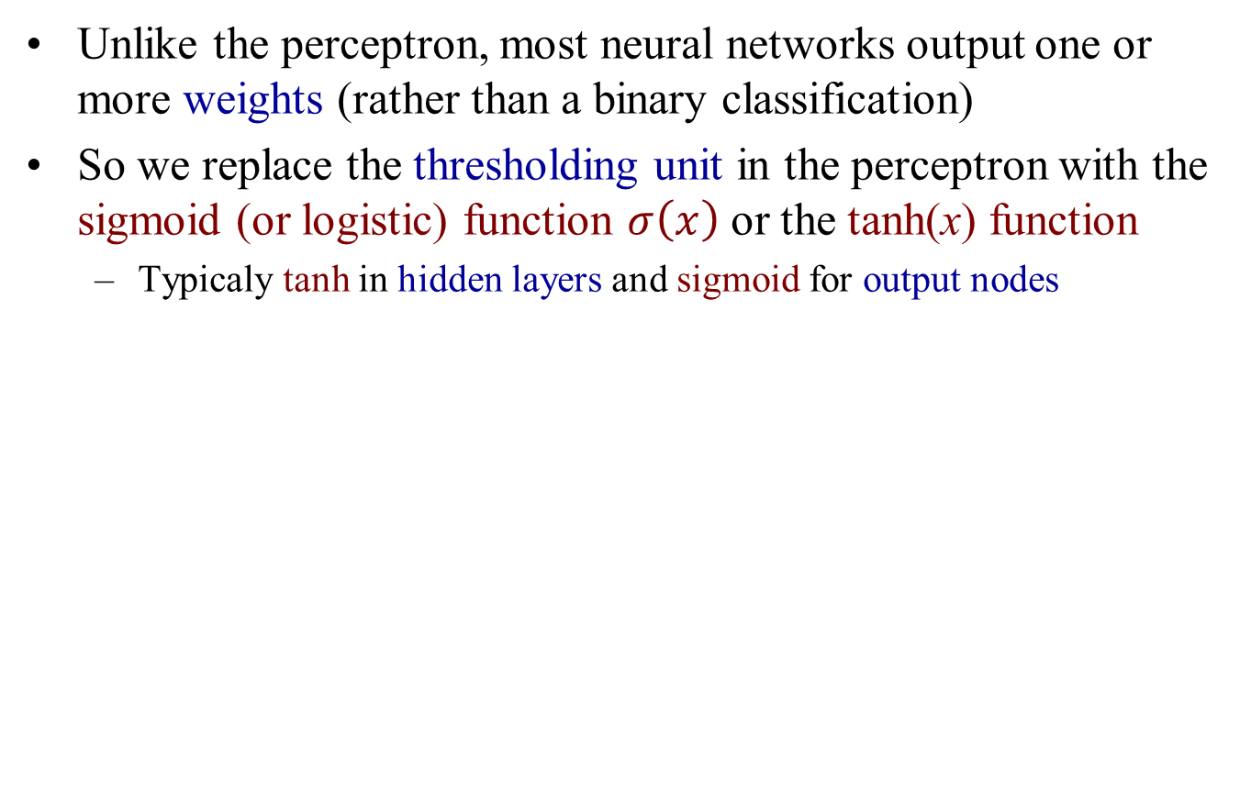
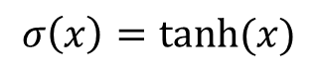
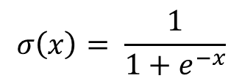
Network output
Unlike the perceptron, most neural networks output one or more weights (rather than a binary classification)
So we replace the thresholding unit in the perceptron with the sigmoid (or logistic) function $σ\left(x\right)$ or the tanh(x) function
Typicaly tanh in hidden layers and sigmoid for output nodes
$$σ\left(x\right)= \frac{1}{1+e^{−x}}$$
$$σ\left(x\right)=tanh⁡(x)$$
Nonlinear
Differentiable

Slide 8

Backpropagation
The backpropagation algorithm learns weights for a multilayer network (with fixed structure)
It uses gradient descent to (attempt to) minimize the squared error between the target values and the network output values (for the training data)
x_{d1}
o_{1d}
x_{d2}
o_{2d}
x_{d3}
$$w_{in}$$
$$w_{out}$$
$$E\left(w\right)= \frac{1}{2}\sum_{d∈D}{ \sum_{k∈outputs}{{\left(y_{kd}−o_{kd}\right)}^{2}}}$$
Feedforward network with two layers of sigmoid units including 4 hidden units
$${w=(w}_{in}, w_{out})$$
Target (label)
Network output
… of the k^{th} output unit for the d^{th} training example
Backprop trains the network by iteratively propagating errors backwards from output units

Slide 9
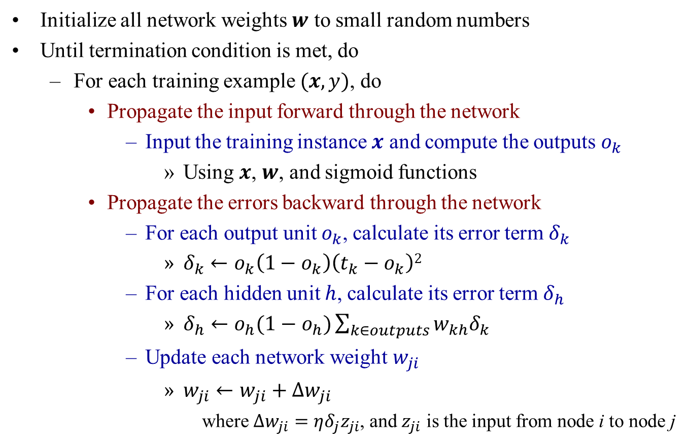
The Backpropagation algorithm
x₁
o₁
x₂
Initialize all network weights $w$ to small random numbers
Until termination condition is met, do
For each training example $(x,y)$, do
Propagate the input forward through the network
Input the training instance $x$ and compute the outputs $o_{k}$
Using $x$, $w$, and sigmoid functions
Propagate the errors backward through the network
For each output unit $o_{k}$, calculate its error term $δ_{k}$
$δ_{k}←o_{k}\left(1−o_{k}\right)\left(t_{k}−o_{k}\right)2$
For each hidden unit $h$, calculate its error term $δ_{h}$
$δ_{h}←o_{h}(1−o_{h})\sum_{k∈outputs}{w_{kh}δ_{k}}$
Update each network weight $w_{ji}$
$w_{ji}←w_{ji}+∆w_{ji}$
where $∆w_{ji}=ηδ_{j}z_{ji}$, and $z_{ji}$ is the input from node i to node j
o₂
x₃
$$w_{in}$$
$$w_{out}$$

Slide 10
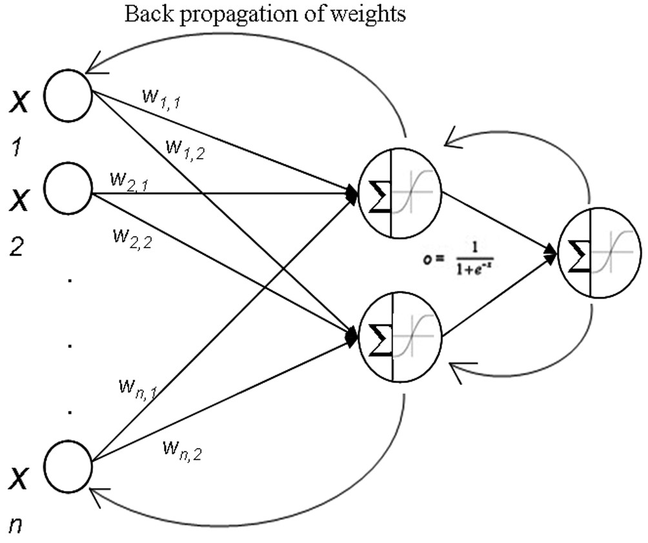
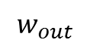
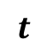
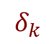
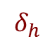
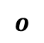
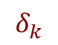
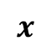
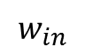
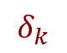
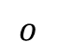
The Backpropagation algorithm
Iterative procedure:
Apply training data x and feed forward to outputs
Use training labels t to determine output errors
Propagate errors backwards, updating all weights
Lather, rinse, repeat…
$$o$$
$$δ_{k}$$
$$δ_{h}$$
$$x$$
$$o$$
$$w_{in}$$
$$δ_{k}$$
$$w_{out}$$
$$δ_{k}$$
$$t$$
Updating weights

Slide 11
The Backpropagation algorithm
Implements a gradient descent search through the hypothesis space
Acts linearly early on, when the weights are small, since the sigmoid function for is approximately linear for small inputs
When the weights grow, the network starts to learn nonlinearly
Errors propagate backwards
Same process for more layers
Training can be quite slow
Converges to local minimum (if given enough time)
Methods to avoid local minimum trap problem include:
Run multiple times with different initial weights
Use a weight momentum term in the weight update rule
Stochastic gradient descent
Etc….

Slide 12
Backpropagation: comments
What is the hypothesis space of Backpropagation?
The N-dimensional Euclidian space of the N network weights
High-dimensional!
Since the hypothesis space is continuous and the error function E is differentiable with respect to the weights, it makes an efficient gradient descent approach possible
What is the inductive bias of Backpropagation? (The way generalization is enforced beyond the data points)
It’s hard to state precisely, but roughly it’s smooth interpolation between data points or convexity
I.e., if two positive training example have no negative example between them, backprop tends to label the points in between as positive as well

Slide 13
Backpropagation: comments (cont.)
There are multiple choices for the termination condition for updating weights
A fixed number of iterations (but how many?)
Until the error E falls below some predetermined threshold
Backpropagation is susceptible to overfitting the training data, thus decreasing generalization to unseen examples
Validation data comes in very useful here
Typical strategy: Use the training data to train the network, but after every iteration measure error on the validation set
Choose the model (weights) that give the smallest error on the validation set
This is a cross-validation approach

Slide 14
Feedforward neural networks
Every Boolean function can be represented by a two-layer network (one hidden unit layer)
Though the number of hidden units required may be very large
Every bounded continuous function can be approximated with arbitrarily small error by a two-layer network
Using sigmoid units in the hidden layer and linear (unthresholded) units at the output layer
Any function can be approximated to arbitrary accuracy by a three-layer network
Using sigmoid units in the hidden layers and linear (unthresholded) units at the output layer

Slide 15
Some other Machine Learning topics
Miscellaneous…

Slide 16
Reinforcement learning
There are many situations where we don’t know the correct answers that supervised learning requires
Reinforcement learning is the problem faced by an agent that learns behavior (to achieve a goal) through trial-and-error interactions with a dynamic environment based on a reward signal (rather than through supervision)
Discover which actions yield the most (cumulative) reward by trying them; i.e., learning by experience
Examples:
Game playing (e.g., chess): player knows whether it wins or loses, but not know how to move at each step
Control: a robot juggler
Mobile robot navigation
Teaching CS courses

Slide 17
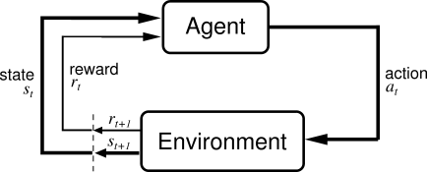
Reinforcement learning
Rewards from sequences of actions
Learn action to maximize payoff
Not much information in a payoff signal
Payoff is often delayed
How do we learn to choose the actions to maximize reward? This is the problem addressed by RL
In contrast to supervised learning, the reward only tells us whether the action we chose was good or bad (or led to a good or bad result), not what would have been the “correct” action
Also, the actions we take and the reward can be separated temporally, so that the problem arises how to assign the reward signal to actions
Thus, reinforcement learning has some aspects of supervised learning, but with a very “poor” teacher!

Slide 18
Reinforcement learning: Q-learning
Q-learning (1989) is a reinforcement learning technique that finds an optimal action-selection policy for any given (finite) Markov decision process (defining states, actions, and rewards)
It learns an action-value function that gives the expected utility of taking a given action in a given state and following the optimal policy (the action with the highest value in each state) thereafter
Convergence may be slow…
There are many variations…
Reinforcement learning is a very active area of machine learning!

Slide 19
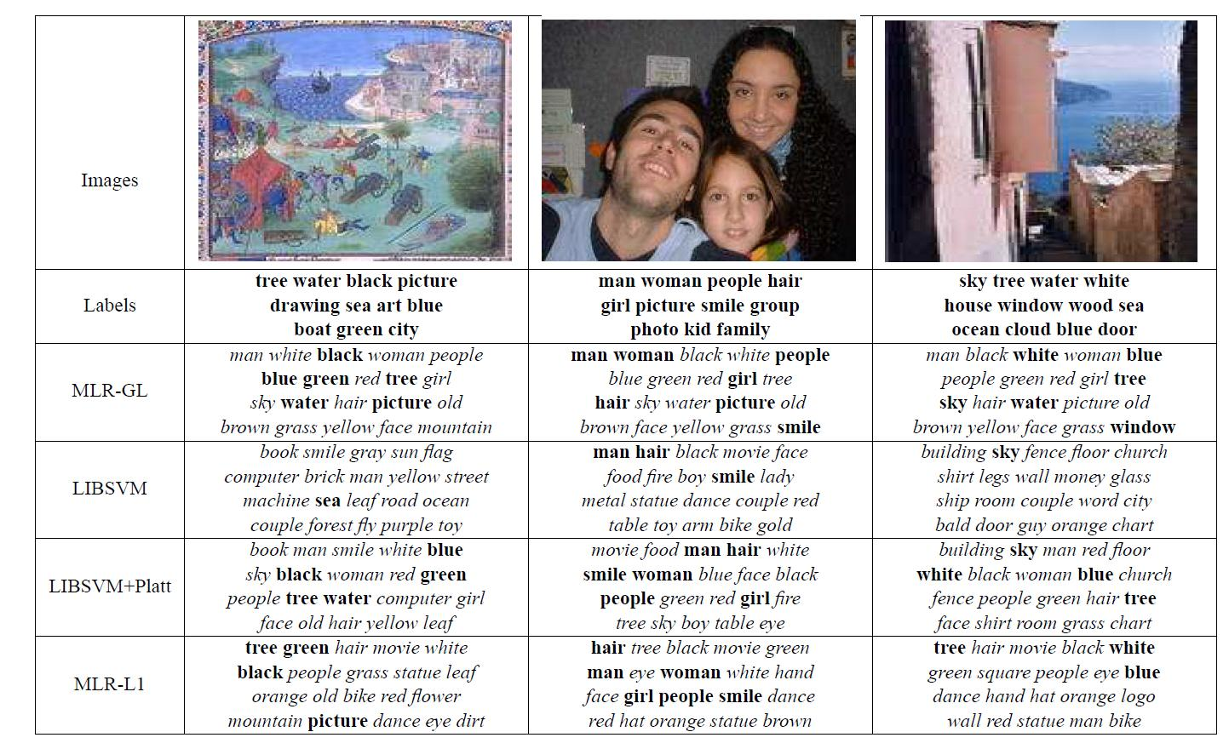
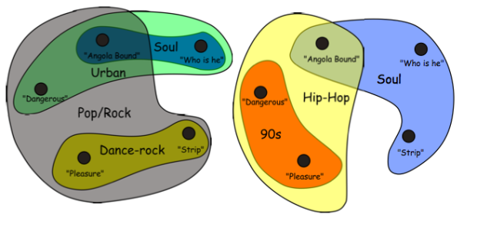
Multi-label classification
In some problems, class labels are not mutually exclusive
E.g., tagging a blog post, labeling an outdoor scene, categorizing a document, medical diagnosis, music categorization
In multi-label classification, the dependence between labels (classes) is learned, as well as the feature-to-class mapping

Slide 20
Transfer learning (a.k.a. inductive transfer)
Traditional ML
Transfer learning focuses on applying knowledge and skills from one problem to a different but related problem
I.e., transferring learning across domains
In some domains, labeled data may be scarce
For example:
Learning to walk → learning to run
Playing the trumpet → playing the French horn
Playing the trumpet → playing the guitar
Learning French → learning to speak Italian
WiFi localization in different spaces
Sentiment classification
Model
Model
Transform Learning
Model
Knowledge
Model

Slide 21
Online (incremental) learning
Sometimes data is not available all at once; it may become available sequentially over time
Online learning (incremental learning) updates the model each time a new data point arrives
Learning takes place continuously, rather than one-shot (batch) learning then applying the learned model
For example:
Visual tracking
User modeling
Intelligent agents
Sequence prediction
Many traditional ML techniques have incremental versions
SVM, PCA, GMM, regression methods, …

Slide 22
Active learning
Active learning is a type of semi-supervised learning in which the algorithm queries the information source (e.g., the user) to obtain the desired model
Sub-problem: Given the labeled data points and tentative model, which data point should be labeled/explored next?
E.g., in robotics – where to point the camera or sensors in order to gain the most useful information?
Typically, there are relatively few labeled data points and very many unlabeled data points (or things that can be explored) – but limited resources or time in which to do so
Labeling/exploration can be expensive and time-consuming
Some methods exploit structure in the data to infer which unlabeled points would be most helpful to label

Slide 23
Active learning
Which of the unlabeled points would be most useful to label?

Slide 24
Deep learning
Deep learning is about learning deep (many-layered) neural networks – multiple non-linear transformations
Biological motivation: The human brain is a deep neural network, has many layers of neurons which acts as feature detectors, detecting more and more abstract features as you go up
The more layers in a network, the more abstract features can be represented
E.g. to classify or detect a cat in an image:
Bottom layers: Edge detectors, curves, corners straight lines
Middle layers: Fur patterns, eyes, ears
Higher layers: Body, head, legs
Top layer: Cat

Slide 25
Deep network structure
Although 2- and 3-layer neural networks have been shown to be able to approximate any function, they may require exponential size
I.e., very wide, shallow networks
In a deep network, higher levels can express combinations between features learned at lower levels
Shallow network
Deep network

Slide 26
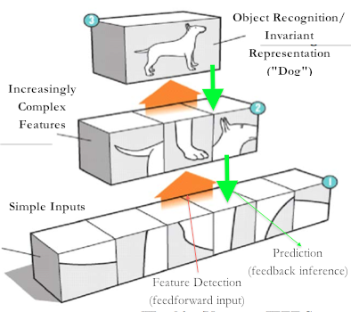
Deep learning
Each level creates new (more complex or abstract) features from combinations of features from the level below

Slide 27
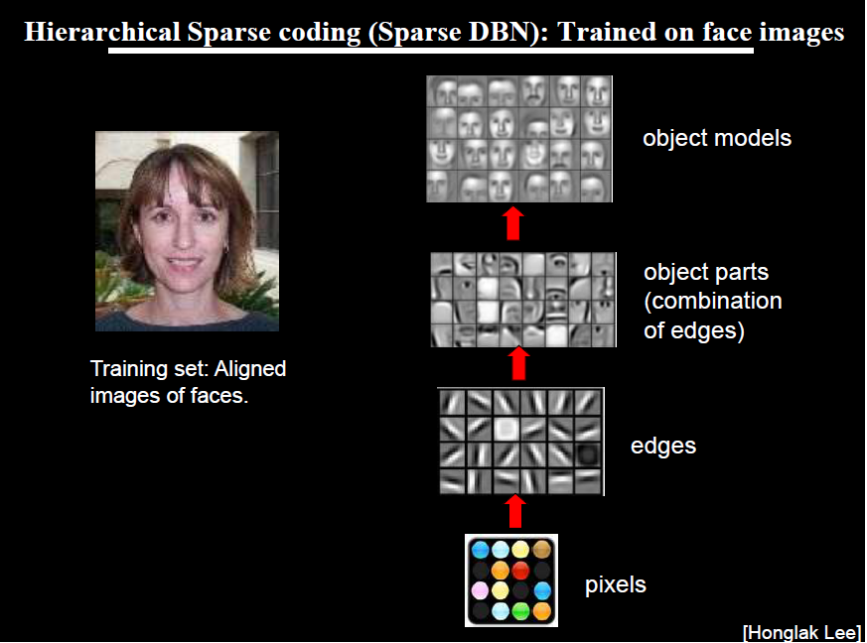

Slide 28
Deep learning
The traditional neural network approach is to use back propagation (or similar methods) to train multiple layers
But back propagation does not work well over several layers, does not scale well, and cannot leverage unlabeled data
Recent advances in deep learning attempt to address these short-comings
Deep networks take advantage of unlabeled data by learning good representations of the data through unsupervised learning
Reduces the need for manual “feature engineering”
Latent (hidden) features are learned from the unlabeled data
So deep learning is a semi-supervised approach that combines bottom-up, unsupervised training with backprop-like training on labeled data

Slide 29
Success of deep learning
State-of-the-art performance in a wide range of different areas:
Language Modeling (2012, Mikolov et al.)
Image Recognition (2012 ImageNet competition, Krizhevsky)
Sentiment Classification (2011, Socher et al.)
Speech Recognition (2010, Dahl et al.)
MNIST hand-written digit recognition (2010, Ciresan et al.)
What do these problems have in common?
Each are non-linear classification problems where the information is highly hierarchal in nature
Problems that humans excel at and machines do very poorly
Andrew Ng – Machine Learning Professor, Stanford/Baidu:
“I’ve worked all my life in Machine Learning, and I’ve never seen one algorithm knock over benchmarks like Deep Learning.”

Slide 30
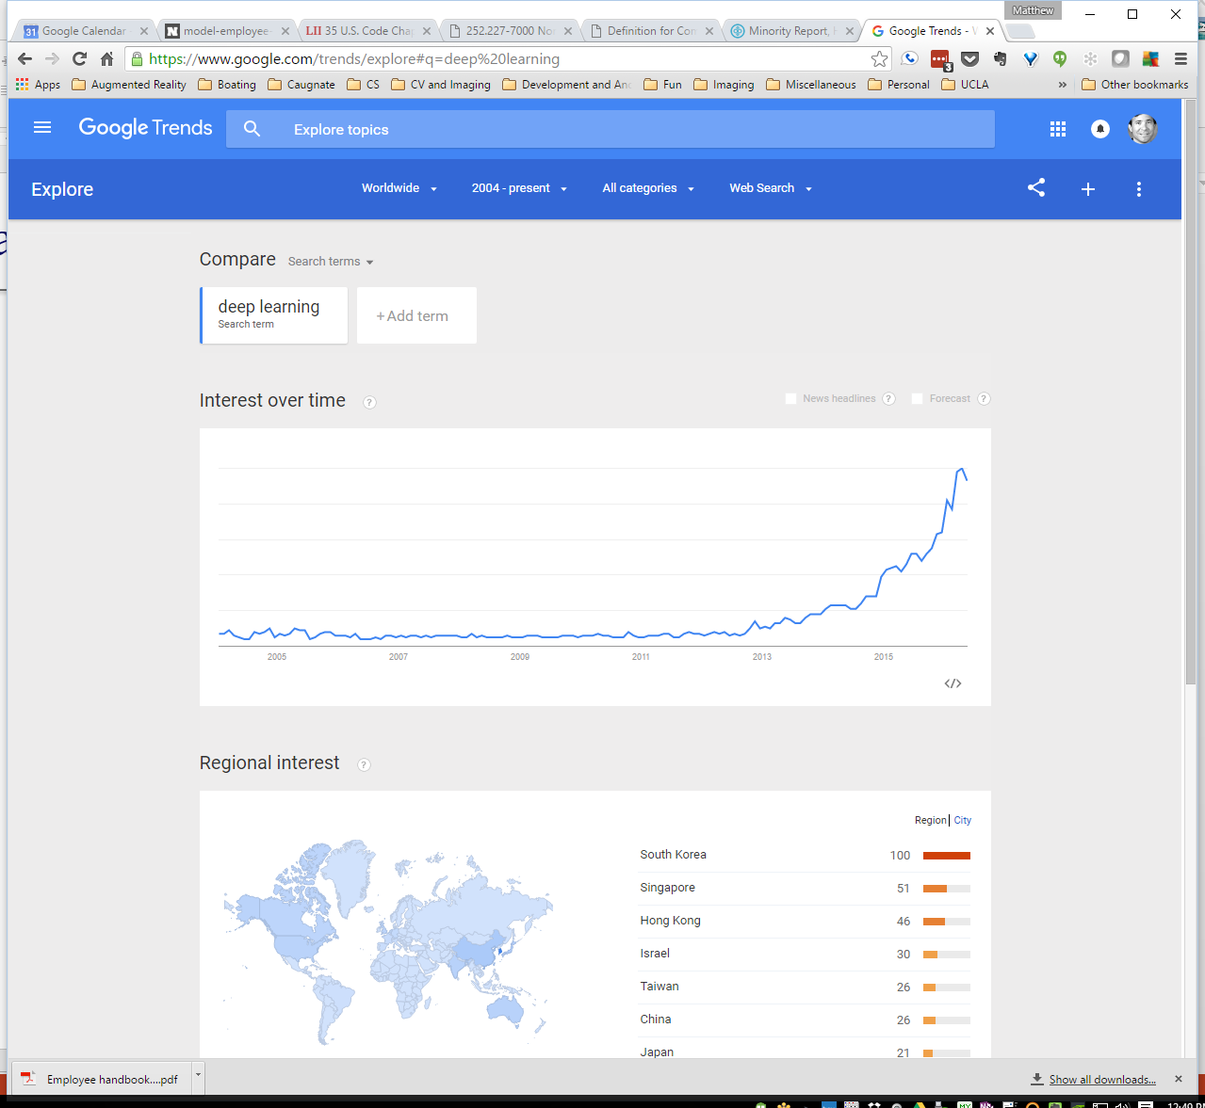
Popularity of deep learning
Google Trends for “Deep learning”

Slide 31
Some disadvantages of deep learning
The models are very complex, with lots of parameters to choose and optimize:
Number of layers, size of layers, node functions
Very slow to train
Some problems more amenable to deep learning than other applications
Simpler models may be sufficient for many domains
The learned models can be very hard to explain (e.g., compared with decision trees)
What does neuron 524 do?
Is deep learning being over-hyped?

Slide 32







What’s Hot in Machine Learning
You mean besides deep learning???
Did I mention deep learning?
Deep convolutional networks
Recurrent networks
Tensor methods
Big data, data science, data analytics
Applications to… everything
Personal agents (Siri, Google Now, Amazon Echo, etc.)
And don’t forget… deep learning!

